Slide 1
What Is the Future of Neoadjuvant ARI Intensification in Localized Prostate Cancer?
Rana R. McKay
Associate Professor of Medicine and Urology
Associate Director, Translational Sciences
Disease Team Co-Lead, Genitourinary Oncology Program
Moores Cancer Center
La Jolla, CA

Slide 2
Resource Information
About This Resource
These slides are one component of a continuing education program available online at MedEd On The Go titled Prostate Cancer: Focusing Androgen Receptor Inhibitors on High-Risk Localized & Locally Advanced Disease
Program Learning Objectives:
Describe the risk of developing metastases and cancer-related mortality based on risk stratification in localized prostate cancer
Assess the evolving changes in guideline recommendations for high-risk localized and locally advanced prostate cancer and where ARIs fit into these recommendations
Evaluate the efficacy and safety of second-generation ARI therapy in patients with newly diagnosed prostate cancer who have high-risk localized or locally advanced disease
Employ effective multidisciplinary adverse effect management strategies to improve ARI treatment adherence
MedEd On The Go®
www.mededonthego.com
This content or portions thereof may not be published, posted online or used in presentations without permission.
This content can be saved for personal use (non-commercial use only) with credit given to the resource authors.
To contact us regarding inaccuracies, omissions or permissions please email us at support@MedEdOTG.com

Slide 3
Disclaimer
The views and opinions expressed in this educational activity are those of the faculty and do not necessarily represent the views of Total CME, LLC, the CME providers, or the companies providing educational grants. This presentation is not intended to define an exclusive course of patient management; the participant should use their clinical judgment, knowledge, experience, and diagnostic skills in applying or adopting for professional use any of the information provided herein. Any procedures, medications, or other courses of diagnosis or treatment discussed or suggested in this activity should not be used by clinicians without evaluation of their patient's conditions and possible contraindications or dangers in use, review of any applicable manufacturer’s product information, and comparison with recommendations of other authorities. Links to other sites may be provided as additional sources of information.

Slide 4
Treatment Paradigms for High-Risk Prostate Cancer
Neoadjuvant Treatment
Standard of care for breast, rectal, bladder and other cancers given improved long-term survival
Down-stage local disease, which may facilitate surgical resection
Reduce or delay post-surgical treatment
Provide an in vivo assessment of response to treatment
Prostatectomy
Radiation + ADT
Radiation + ADT
Treatment
?
Prostatectomy
ADT, androgen deprivation therapy.
Berger AC, et al. J Clin Oncol. 2005;23(19)4330-7; Cortazar P, et al. Lancet. 2014;384(9938):164-72; Mass M, et al. Lancet Oncol. 2010;11(9):835-44; McKay RR, et al. Drugs. 2012; Pertrelli F, et al. Eur Urol. 2014;65(2):350-7.

Slide 5
Neoadjuvant Clinical Trials in Prostate Cancer
Historic Neoadjuvant Trials
Contemporary Neoadjuvant Trials
Investigated LHRH agonists +/- first generation antiandrogens
Majority of patients with low-risk disease
Did not systematically evaluate pathologic response
Limited long-term follow-up
Investigated more potent androgen targeting agents (abiraterone acetate [henceforth abiraterone], enzalutamide, apalutamide)
Majority of patients with high-risk disease
Systematic central pathology review to evaluate response
Long-term follow-up ongoing
LHRH, luteinizing hormone-releasing hormone.

Slide 6
Pathologic Responses from Potent Neoadjuvant Therapy
Conducted a series of neoadjuvant trials over the last 10 years
Phase 2 biomarker integrated trials evaluating potent neoadjuvant hormone therapy
 | NeoAbi (n=58) | NeoEnza (n=48) | NeoAbiEnza (n=75) | NeoAbiApa (n=117)
Arms | 12wAbi vs. 24wAbi | Enza vs. EDL | EL vs. APEL | APL vs. APAL
pCR | 4% vs. 10% | 0% vs. 4% | 8 vs. 10% | 10% vs. 13%
MRD* | 0% vs. 14% | 0% vs. 13% | 8% vs. 20% | 10% vs. 9%
pCR + MRD | 4% vs. 24% | 0% vs. 17% | 16% vs. 30% | 20% vs. 22%
Abi=Abiraterone; Enza=Enzalutamide; EDL=Enzalutamide, dutasteride, leuprolide; APEL=Abiraterone, prednisone, enzalutamide, leuprolide; EL=Enzalutamide, leuprolide; APAL=Abiraterone, prednisone, apalutamide, leuprolide; APL=Abiraterone, prednisone, leuprolide; pCR= pathologic complete response; MRD=Minimum residual disease. *Defined as residual tumor with largest cross section dimension ≤ 0.3-0.5 cm.
Taplin ME, et al. JCO. 2014; 32(33):3705-15.
Montgomery B, et al. Clin Cancer Res. 2017; 23(9):2169-2176.
McKay RR, et al. JCO. 2019;37(11):923-31.
McKay RR et al,.J Urol. 2021;205(6):1689-97.

Slide 7
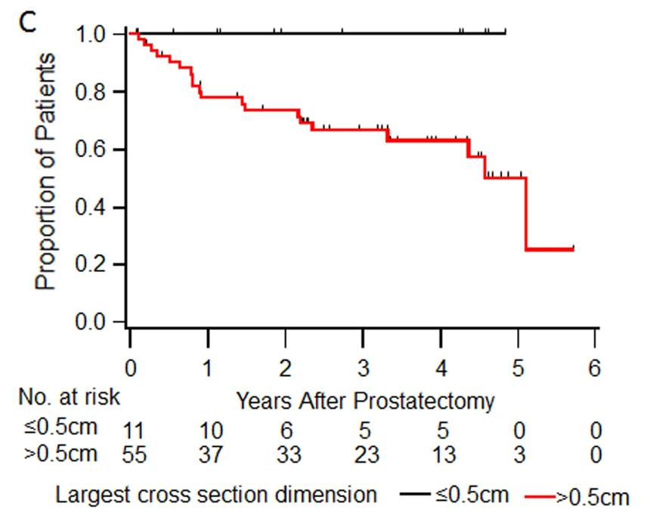
Correlation of Pathologic Response with PSA Recurrence
Pooled analysis of three contemporary neoadjuvant studies (n=72)
Median follow-up 3.4 years
No recurrences observed in patients with a pCR or MRD at radical prostatectomy
pCR=Pathologic complete response; MRD=Minimum residual disease.
McKay RR, et al. Prostate Cancer Prostatic Dis, 2018;21(3):364-72.

Slide 8
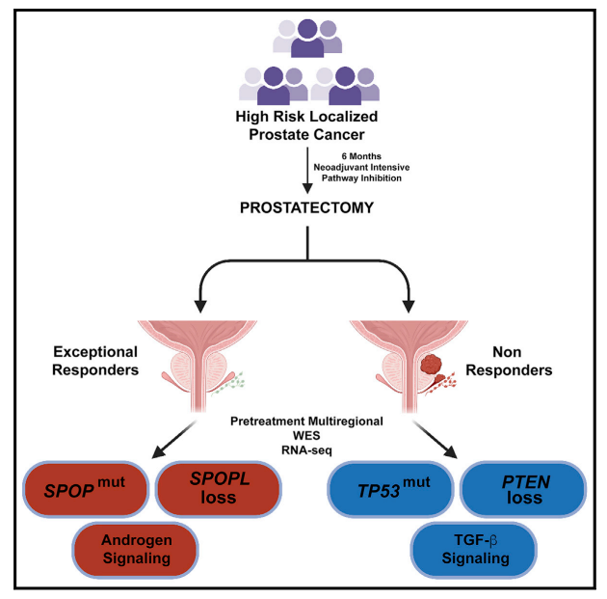
Molecular Features of Exceptional Responders
Derived from multi-regional pretreatment biopsies in exceptional responders (pCR or MRD) and non-responders (ypT3 and/or N1 at radical prostatectomy)
Multi-regional WES and RNASeq
WES, whole exome sequencing.
Tewari A, et al. Cell Rep. 2021;36(109665):1-10.

Slide 9
Critical Paths for the Future of Neoadjuvant Therapy
Standardized pathologic endpoints
Surrogacy of pathologic endpoints with metastasis-free survival and overall survival
Integration of biomarkers to optimize therapy selection
Integration of imaging to assess response

Slide 10
PROTEUS
Randomized, Double-blind, Placebo-Controlled, Phase 3 Study of Apalutamide in Subjects with High-Risk, Localized or Locally Advanced Prostate Cancer Who are Candidates for Radical Prostatectomy
APA, apalutamide; BCF, biochemical failure; GG, Grade Group; GS, Gleason score; NA, North America; PBO, placebo; PFS, progression-free survival; ROW rest of world; RP, radical prostatectomy; RT, radiation therapy.
Janssen Research & Development, LLC. ClinicalTrials.gov Identifier: NCT03767244. Updated June 29, 2023.

Slide 11
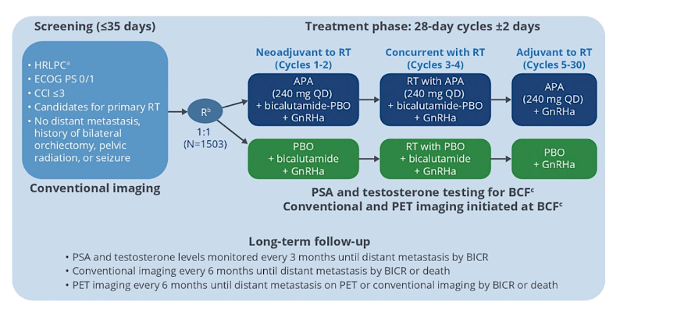
ATLAS Trial
BICR, blinded independent central review; CCI, Charlson Comorbidity Index; GnRHa, gonadotropin-releasing hormone antagonist; HRLPC, high-risk localized or advanced prostate cancer; PET, positron emission tomography; R, randomized.
Sandler HM, et al. J Clin Oncol. 2016;10(7-8Suppl3):S140-3

Slide 12
Conclusions
Currently, there is no phase 3 data to support neoadjuvant systemic therapy with radical prostatectomy
Phase 2 data shows promise for ADT with second-generation agents, including favorable pathologic complete response, minimal residual disease, PSA relapse, and salvage therapy rates
The phase 3 PROTEUS trial completed accrual of 2,000 participants, with a co-primary endpoint of pathologic complete response/minimal residual disease and radiographic progression-free survival. It will also be important if this trial can validate pathological complete response rate as a surrogate for radiographic progression-free survival
Biomarkers suggest favorable response in SPOP mutated and poor response in TP53 mutated and ERG+/PTEN-loss
Future trials are investigating novel strategies, including novel combinations (PARP inhibitors, immunotherapy, targeted therapy), biomarker stratification, and PSMA-PET as a biomarker of response
PARP, poly-ADP ribose polymerase; PSMA, prostate-specific membrane antigen.

Slide 13
Looking for more resources on this topic?
CME/CE in minutes
Congress highlights
Late-breaking data
Quizzes
Webinars
In-person events
Slides & resources
www.MedEdOTG.com

