Slide 1
The Epidemiology of Sleepiness in Obstructive Sleep Apnea
Atul Malhotra, MD
Peter C. Farrell Presidential Chair and Tenured Professor in Respiratory Medicine
Research Chief of Pulmonary, Critical Care and Sleep Medicine
University of California San Diego
La Jolla, CA

Slide 2
Resource Information
About This Resource
These slides are one component of a continuing education program available online at MedEd On The Go titled Obstructive Sleep Apnea: Emerging Therapies for Excessive Daytime Sleepiness
Program Learning Objectives:
Utilize validated diagnostic tools when assessing residual EDS due to OSA.
Understand the burden, risk factors, and prevalence of EDS due to OSA.
Develop an evidence-based, comprehensive treatment plan for the management of EDS due to OSA.
MedEd On The Go®
www.mededonthego.com
This content or portions thereof may not be published, posted online or used in presentations without permission.
This content can be saved for personal use (non-commercial use only) with credit given to the resource authors.
To contact us regarding inaccuracies, omissions or permissions please email us at support@MedEdOTG.com

Slide 3
Disclaimer
The views and opinions expressed in this educational activity are those of the faculty and do not necessarily represent the views of Total CME, LLC, the CME providers, or the companies providing educational grants. This presentation is not intended to define an exclusive course of patient management; the participant should use their clinical judgment, knowledge, experience, and diagnostic skills in applying or adopting for professional use any of the information provided herein. Any procedures, medications, or other courses of diagnosis or treatment discussed or suggested in this activity should not be used by clinicians without evaluation of their patient's conditions and possible contraindications or dangers in use, review of any applicable manufacturer’s product information, and comparison with recommendations of other authorities. Links to other sites may be provided as additional sources of information.

Slide 4
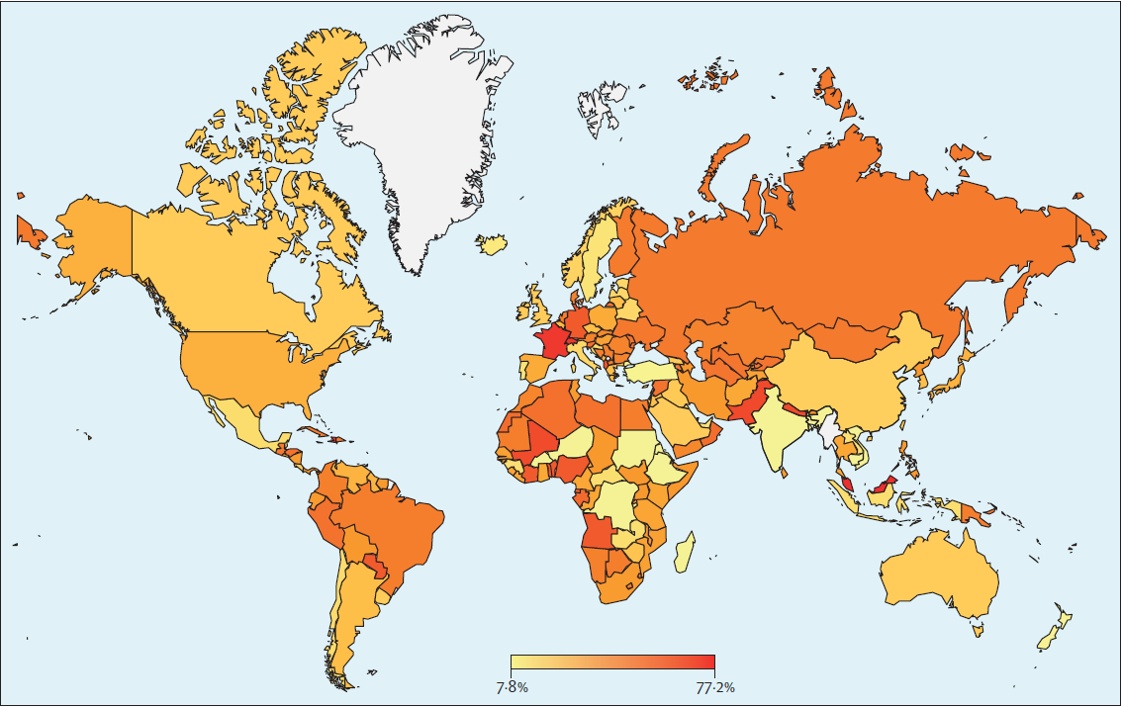
AHI ≥ 5
936,360,689

Slide 5
SDB + Sleepiness
1993 study
AHI >5 events/h
24% of men
9% of women
AHI >5 events/h with symptoms of sleepiness*
4% of men
2% of women
Prevalence figures have increased over time, but the minority of patients have sleepiness
Major difference between clinic-based and community-based studies

Slide 6
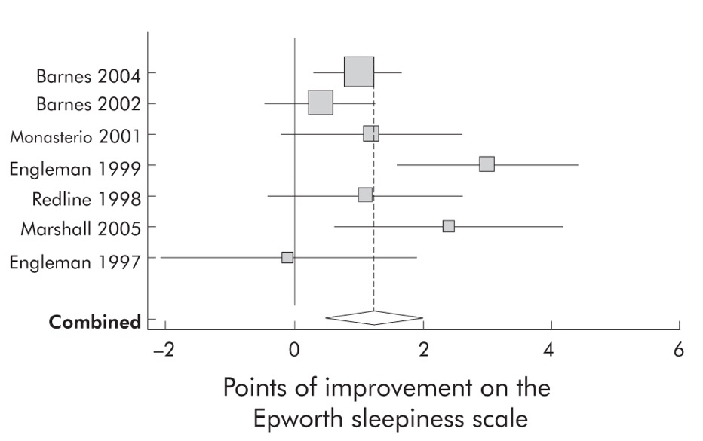
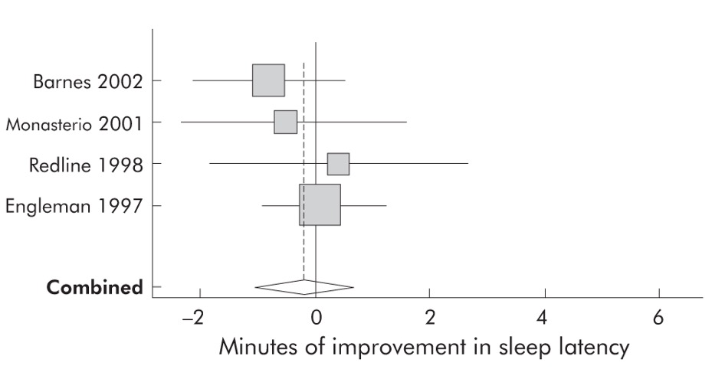
CPAP Reduces Subjective but Not Objective Sleepiness

Slide 7
Prevalence of Sleepiness in 1047 Patients with OSA in the French National Sleep Registry
Baseline
Follow-up on CPAP
Baseline
Follow-up on CPAP
Not Sleepy
492
Sleepy
602
ESS 15 → 6
Not Sleepy
420
ESS 6 → 4
Not Sleepy
445
Sleepy
110
Sleepy
25
ESS 7 → 12
ESS 16 → 13
58% were sleepy at baseline
13% were sleepy at follow-up

Slide 8
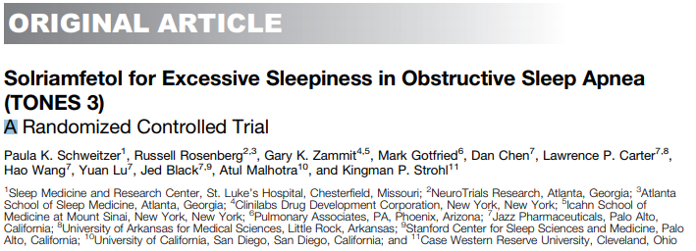
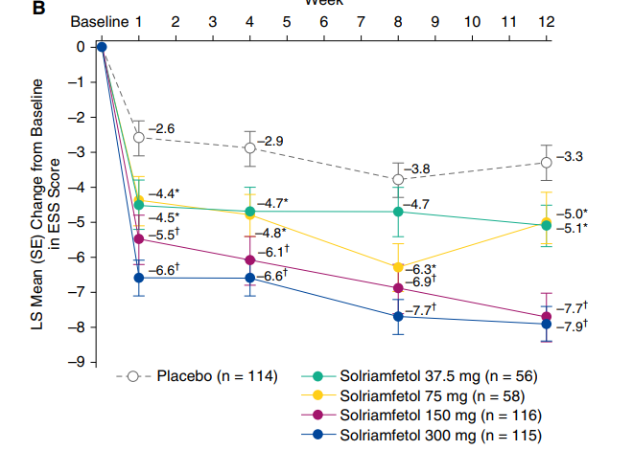
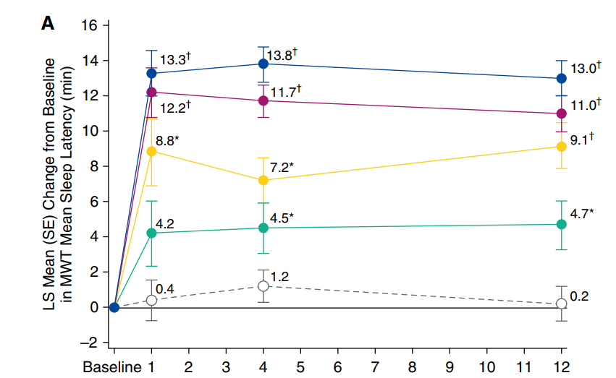
AJRCCM 2019
Week
Week

Slide 9
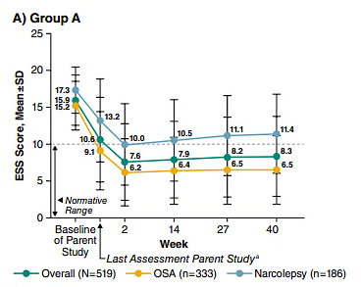
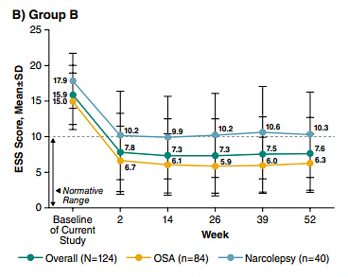
N=643
Sleep 2020

Slide 10
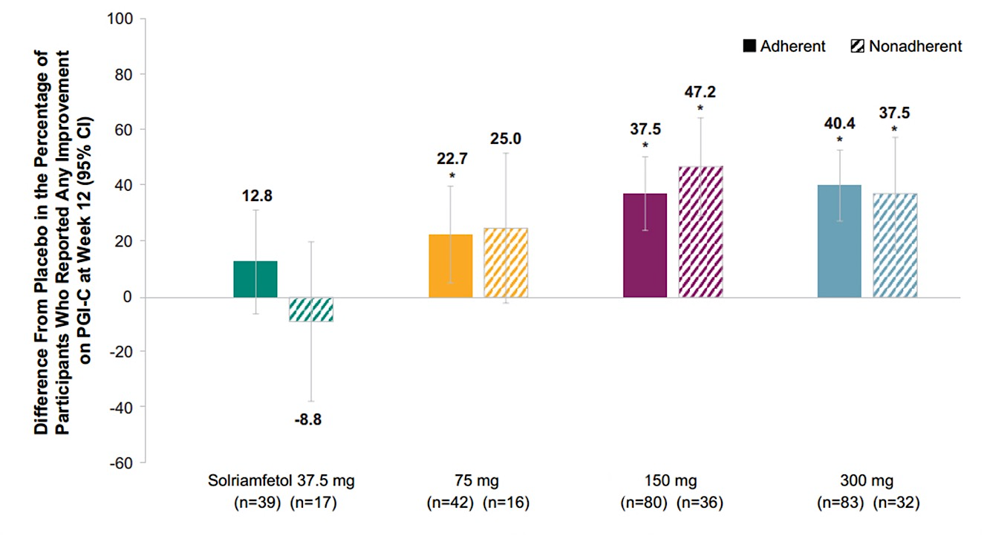
Randomized Controlled Trial of Solriamfetol for Excessive Daytime Sleepiness in Obstructive Sleep Apnea: An Analysis of Subgroups Adherent or Nonadherent to Obstructive Sleep Apnea Treatment
Short title/running head: Solriamfetol and Primary OSA Therapy Use
Paula K. Schweitzer, PhD¹; Geert Mayer, MD²; Russell Rosenberg, PhD³; Atul Malhotra, MD4; Gary K. Zammit, PhD^{5,6}; Mark Gotfried, MD⁷; Patricia Chandler, MD⁸; Michelle Baladi, PhD⁸; Kingsman P. Strohl, MD⁹

Slide 11
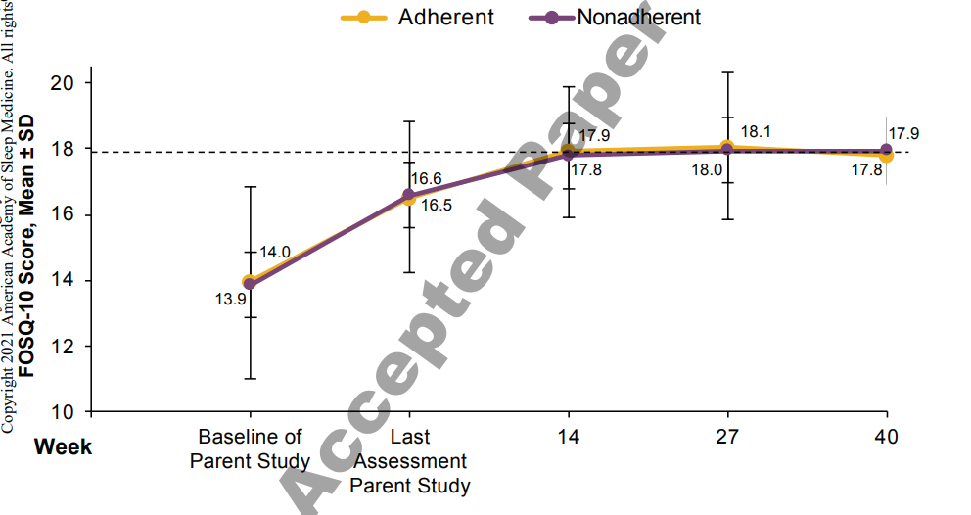
Effects of solriamfetol in a long-term trial of participants with obstructive sleep apnea who are adherent or nonadherent to airway therapy
Paula K. Schweitzer, PhD¹; Kingman P. Strohl, MD²; Geert Mayer, Md^{3,4}; Russell Rosenberg, PhD^{5,6}; Patricia Chandler, MD⁷; Michelle Baladi, PhD⁷; Lawrence Lee, PhD⁷; Atul Malhotra MD⁸

Slide 12
Summary and Take Home Messages
OSA is highly prevalent and treatment is helpful
Nasal CPAP is the treatment of choice and works pretty well
Alternative and adjunctive therapies are available
Future is exciting

Slide 13
Looking for more resources on this topic?
CME/CE in minutes
Congress highlights
Late-breaking data
Quizzes
Webinars
In-person events
Slides & resources
www.MedEdOTG.com

