Slide 1
What Are the Data for TROP2-Targeted ADCs in HR+/HER2-Positive and HER2-Low MBC?
Sarah Sammons, MD Associate Director Metastatic Breast Cancer Dana Farber Cancer Institute Boston, MA

Slide 2
Resource Information
About This Resource
These slides are one component of a continuing education program available online at MedEd On The Go titled Expanding ADCs Across Metastatic Breast Cancer: Disrupting Dx & Tx Silos
Program Learning Objectives:
Correctly determine HER2 expression status in existing and newly diagnosed metastatic breast cancer patients
Develop evidence-based treatment strategies for patients with HR-positive/HER2-low MBC
Differentiate key components and advantages of ADCs in special populations of patients with metastatic breast cancer
Identify strategies for improving adherence through adverse effect management
MedEd On The Go®
www.mededonthego.com
This content or portions thereof may not be published, posted online or used in presentations without permission.
This content can be saved for personal use (non-commercial use only) with credit given to the resource authors.
To contact us regarding inaccuracies, omissions or permissions please email us at support@MedEdOTG.com

Slide 3
Disclaimer
The views and opinions expressed in this educational activity are those of the faculty and do not necessarily represent the views of Total CME, LLC, the CME providers, or the companies providing educational grants. This presentation is not intended to define an exclusive course of patient management; the participant should use their clinical judgment, knowledge, experience, and diagnostic skills in applying or adopting for professional use any of the information provided herein. Any procedures, medications, or other courses of diagnosis or treatment discussed or suggested in this activity should not be used by clinicians without evaluation of their patient's conditions and possible contraindications or dangers in use, review of any applicable manufacturer’s product information, and comparison with recommendations of other authorities. Links to other sites may be provided as additional sources of information.

Slide 4
TROP2 as a Breast Cancer Biomarker
Trophoblast cell surface antigen 2 (TROP2) is a glycoprotein that spans the epithelial membrane surface
TROP2 is associated with tumor growth in a variety of solid epithelial tumors
High TROP2 is associated with poor prognosis and increased tumor growth in breast cancer, including decreased survival

Slide 5
Sacituzumab Govitecan: TROP2–Targeted ADC
TROP2 is expressed in all breast cancer subtypes and is associated with poor prognosis
Humanized Anti–TROP2 Antibody
Targets TROP2, an antigen expressed in many epithelial cancers
Antibody type: hRS7 IgG1κ
SN-38 Payload
Delivers up to 136-fold more SN-38 to tumors than parent compound irinotecan
Unique chemistry improves solubility; selectively delivers SN-38 to tumor
Linker for SN-38
High drug-to-antibody ratio (7.6:1)
pH-sensitive linker for rapid release of payload at or inside tumor
HO
N
O
N
O
O
O
]
H
H
O
O
[
O
N
O
Lys-N
CH₂O
SN-38
7
O
O
N
N
N
O
H
O
N
N
S
Anti–TROP2 mAb
O

Slide 6
TROPiCS-02 Phase 3 Trial
NCT03901339
Metastatic or locally recurrent inoperable HR+/HER2− breast cancer that progressed after:
At least 1 endocrine therapy, taxane, and CDK4/6i in any setting
At least 2, but no more than 4, lines of chemotherapy for metastatic disease
(Neo)adjuvant therapy for early-stage disease qualified as a prior line of chemotherapy if disease recurred within 12 months
Measurable disease by RECIST 1.1
N=543
Treatment was continued until progression or unacceptable toxicity
Sacituzumab govitecan
10 mg/kg IV
days 1 and 8, every 21 days
n=272
Endpoints
Primary
PFS by BICR
Secondary
OS
ORR, DOR, CBR by LIR and BICR
PRO
Safety
R 1:1
Treatment of physician’s choice
(capecitabine, vinorelbine, gemcitabine or eribulin) n=271
Stratification:
Visceral metastases (yes/no)
Endocrine therapy in metastatic setting ≥6 months (yes/no)
Prior lines of chemotherapies (2 vs 3/4)

Slide 7
TROPiCS-02 Phase 3 Trial
 | SG (n=272) | TPC (n=271)
Female, n (%) | 270 (99) | 268 (99)
Median age, y (range) | 57 (29-86) | 55 (27-78)
<65 y, n (%) | 199 (73) | 204 (75)
≥65 y, n (%) | 73 (27) | 67 (25)
Race or ethnic group, n (%)
White | 184 (68) | 178 (66)
Black | 8 (3) | 13 (5)
Asian | 11 (4) | 5 (2)
Otherª / Not reported^{b} | 69 (25) | 75 (28)
ECOG PS, n (%)
0 | 116 (43) | 126 (46)
1 | 156 (57) | 145 (54)
Visceral metastases at baseline, n (%) | 259 (95) | 258 (95)
Liver metastases,^{c} n (%) | 229 (84) | 237 (87)
De novo metastatic breast cancer, n (%) | 78 (29) | 60 (22)
 | SG (n=272) | TPC (n=271)
Median time from initial metastatic diagnosis to randomization, mo (range) | 48.5 (1.2- 243.8) | 46.6 (3.0- 248.8)
Prior chemotherapy in (neo)adjuvant setting, n (%) | 173 (64) | 184 (68)
Prior endocrine therapy use in the metastatic setting ≥6 mo, n (%) | 235 (86) | 234 (86)
Prior CDK4/6 inhibitor use, n (%)
≤12 months | 161 (59) | 166 (61)
>12 months | 106 (39) | 102 (38)
Unknown | 5 (2) | 3 (1)
Median prior chemotherapy regimens in the metastatic setting, n (range)^{d} | 3 (0-8) | 3 (1-5)
All patients had prior CDK4/6 inhibitors and a median of 3 prior chemotherapies

Slide 8
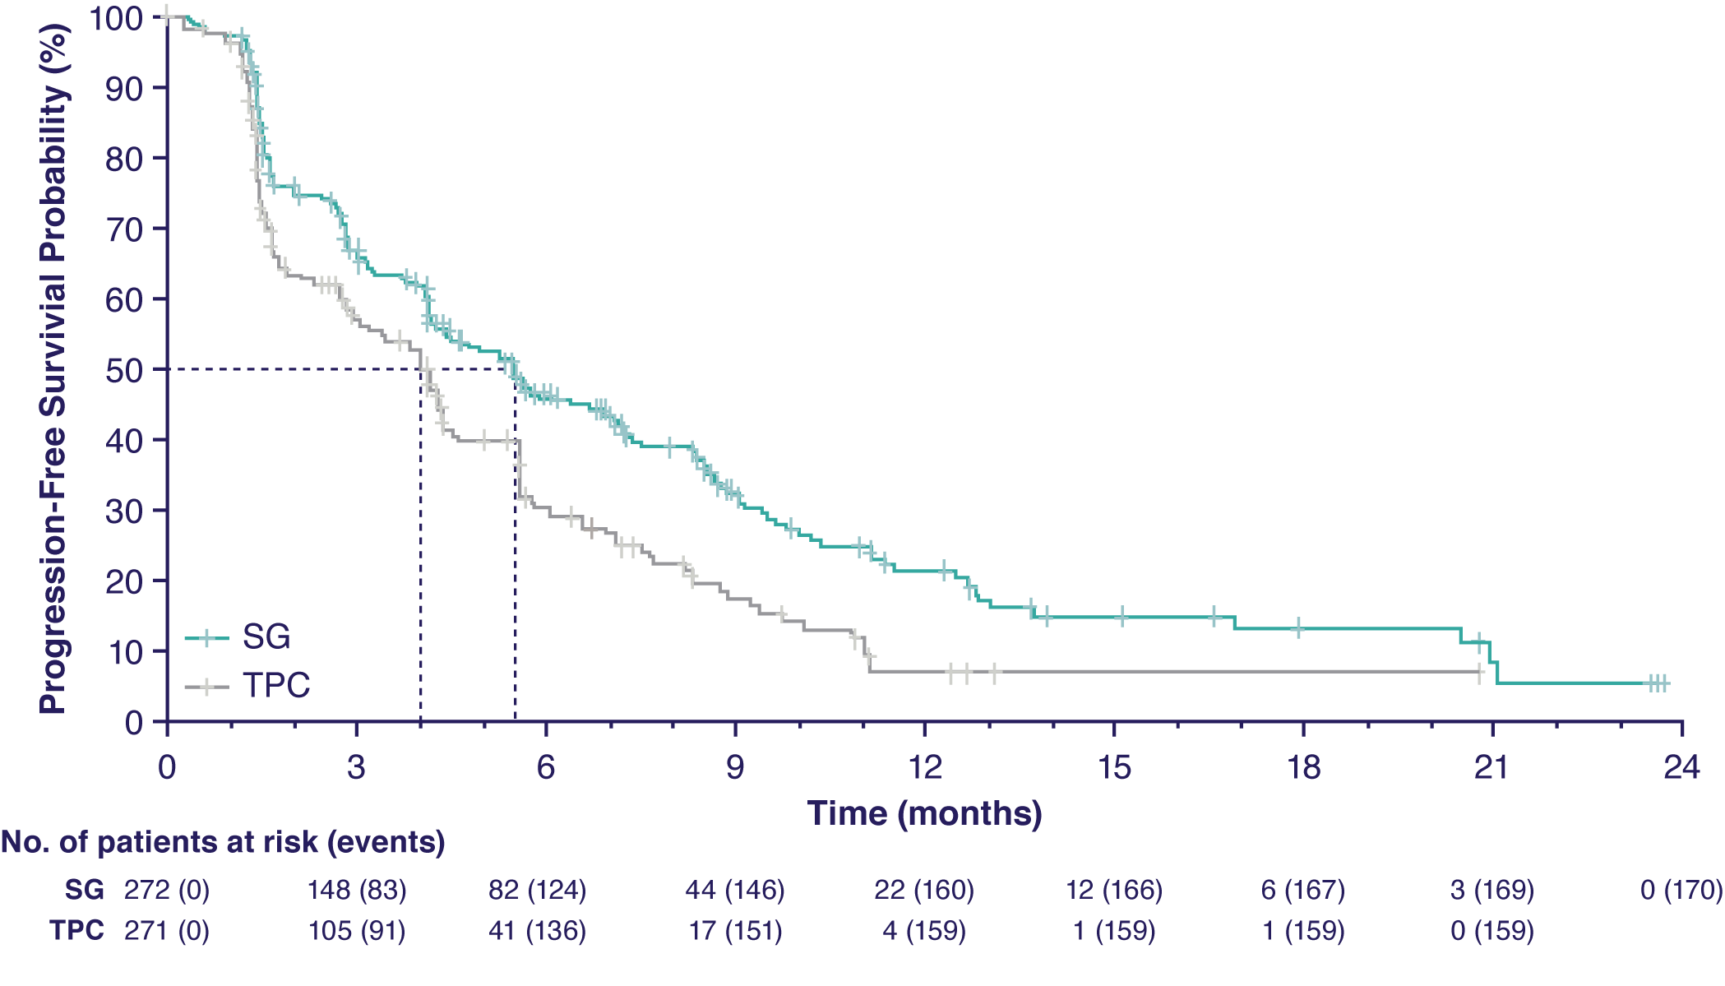
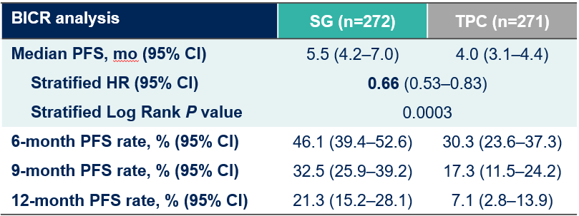
TROPiCS-02 Phase 3 Trial: Improved PFS
SG demonstrated a statistically significant improvement in PFS versus TPC with a 34% reduction in the risk of disease progression/death; a higher proportion of patients were alive and progression-free at all landmark timepoints
6 months
9 months
12 months
BICR analysis | SG (n=272) | TPC (n=271)
Median PFS, mo (95% CI) | 5.5 (4.2–7.0) | 4.0 (3.1–4.4)
Stratified HR (95% CI) | 0.66 (0.53–0.83)
Stratified Log Rank P value | 0.0003
6-month PFS rate, % (95% CI) | 46.1 (39.4–52.6) | 30.3 (23.6–37.3)
9-month PFS rate, % (95% CI) | 32.5 (25.9–39.2) | 17.3 (11.5–24.2)
12-month PFS rate, % (95% CI) | 21.3 (15.2–28.1) | 7.1 (2.8–13.9)
Significant PFS benefit over chemotherapy
Significant ORR benefit (21% vs 14%, p=0.03)
Median follow-up was 10.2 months.

Slide 9
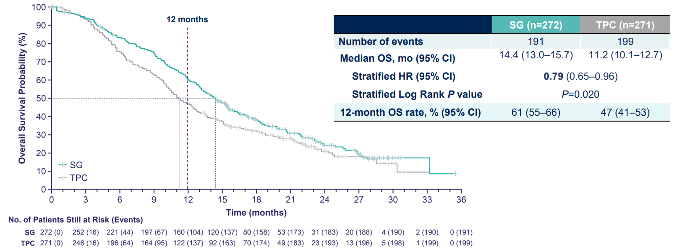
TROPiCS-02 Phase 3 Trial: Overall Survival
Key Secondary Endpoint: Overall Survival (2nd Interim Analysis)

Slide 10
Sacituzumab Improves Outcomes in HER2-Low Subgroup
Within the HER2-Low population, median PFS with SG vs TPC for the IHC1+ and IHC2+ subgroups was 7.0 vs 4.3 (HR, 0.57) and 5.6 vs 4.0 (HR, 0.58) months, respectively
The hazard ratio for median PFS in a sensitivity analysis of the HER2-Low subgroup (excluding ISH- unverifiedb) was similar (HR, 0.53)

Slide 11
Sacituzumab Govitecan Approved in HR+, HER2- Metastatic Breast Cancer
On February 3, 2023, FDA approved sacituzumab govitecan-hziy for HR+, HER2- metastatic breast cancer who have received endocrine based therapies and at least 2 additional therapies
For patients with HR+, HER2- cancers after prior treatment including endocrine therapy, a CDK4/6 inhibitor, and at least two lines of chemotherapy (including a taxane) for advanced breast cancer.
Sacituzumab govitecan-hziy was added to the NCCN guidelines as a category 1 preferred regimen for second-line treatment of HR-positive, HER2-negative metastatic breast cancer, when not a candidate for trastuzumab deruxtecan

Slide 12
Looking for more resources on this topic?
CME/CE in minutes
Congress highlights
Late-breaking data
Quizzes
Webinars
In-person events
Slides & resources
www.MedEdOTG.com

