Slide 1
Recognizing the Early and Subtle Signs and Symptoms of Rett Syndrome
Jeffrey L. Neul, MD, PhD
Director, Vanderbilt Kennedy Center
Annette Schaffer Eskind Professor
Vanderbilt University Medical Center
Nashville, TN

Slide 2
Disclaimer
The views and opinions expressed in this educational activity are those of the faculty and do not necessarily represent the views of TotalCME, Inc., the CME providers, or the companies providing educational grants. This presentation is not intended to define an exclusive course of patient management; the participant should use their clinical judgment, knowledge, experience, and diagnostic skills in applying or adopting for professional use any of the information provided herein. Any procedures, medications, or other courses of diagnosis or treatment discussed or suggested in this activity should not be used by clinicians without evaluation of their patient's conditions and possible contraindications or dangers in use, review of any applicable manufacturer’s product information, and comparison with recommendations of other authorities. Links to other sites may be provided as additional sources of information.

Slide 3



Resource Information
About This Resource
These slides are one component of a continuing education program available online at MedEd On The Go titled New Hope for Rett Syndrome: Novel Treatment Approaches
Program Learning Objectives:
Learn to clearly communicate information that is pertinent to the successful management of RS through each stage of the disease. enhanced patient outcomes and improvements in quality of life.
Increase the ability to recognize the subtle signs and symptoms of RS earlier.
Differentiate the pharmacodynamics and latest efficacy and safety clinical trial data associated with FDA-approved treatment for RTT.
Educate clinicians concerning the role of interprofessional team members in optimizing collaboration and communication to ensure patients with RS receive high-quality care that leads to enhanced patient outcomes and improvements in quality of life
MedEd On The Go®
www.mededonthego.com
This content or portions thereof may not be published, posted online or used in presentations without permission.
This content can be saved for personal use (non-commercial use only) with credit given to the resource authors.
To contact us regarding inaccuracies, omissions or permissions please email us at support@MedEdOTG.com

Slide 4
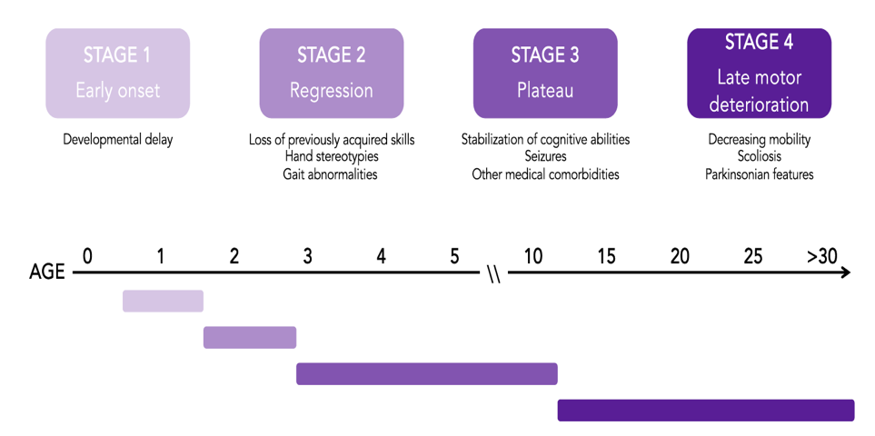


What Is Rett Syndrome (RTT)?
Severe neurodevelopmental disorder
Characteristic disease pattern
Developmental delay
Regression of acquired skills
  Loss of purposeful hand skills
  Loss of spoken language
Onset of characteristic features
  Gait abnormalities
  Stereotypic hand movements
Stabilization of regression
Evolution of clinical issues and changes in motor function
RTT, Rett syndrome.
Collins BE, et al. Neuropsychiatr Dis Treat. 2022;29(18):2813-35; Neul JL. Ann Neurol. 2010;68(6):944-50.

Slide 5

What Is Rett Syndrome (RTT)?
Majority of cases have mutation in X-linked gene MECP2
There are people who clinically have RTT but do not have mutations in MECP2
Occurs mostly, but not exclusively, in girls
~1:10,000 live female births
Amir R, et al. Nat Genet. 1999;23:185-8; Laurvick CL, et al. J Pediatr. 2006;148(3):347-52; Neul JL, et al. Am J Med Genet. 2019;180(1):55-67.

Slide 6
Challenges in Diagnosis
Regression typically occurs between 18-30 months of life.
Average age of diagnosis is 2.7 years
  Less likely to be diagnosed by a pediatrician than by a specialist
  Earlier diagnosis with marked delay in acquisition of basic gross motor skills
  Later diagnosis with normal head circumference
Tarquino DC, et al. Pediatr Neurol. 2015;52(6):585-91.

Slide 7



Challenges in Diagnosis
Developmental delay may be “mild”
  Family concerned that child is not meeting milestones at the same rate of siblings but still within “accepted norms”
Misconception that regression of skills is “rapid”
  Loss of skills may occur quickly in some cases but often occurs over months
  Loss of spoken language and hand skills often occurs at different time points
Confusion about the degree of “regression”
  Does not require complete acquisition of skills
  Does not require complete loss of skills
Neul JL, et al. J Neurodev Disord. 2014;6(1):20.

Slide 8
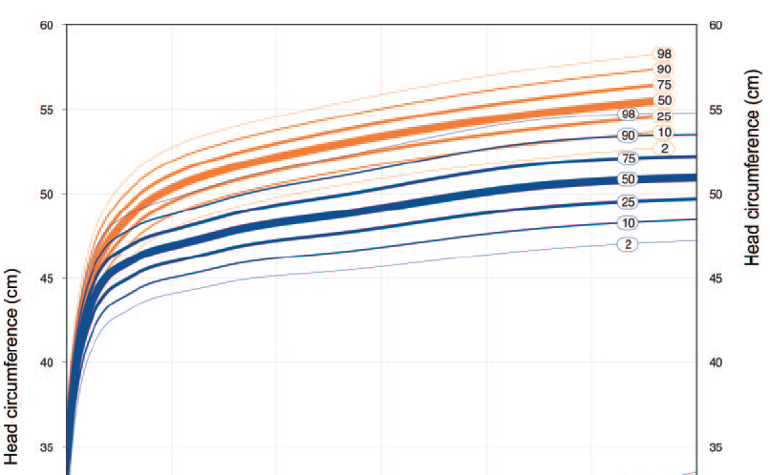
Challenges in Diagnosis
Misconception related to microcephaly
  Not all people with RTT have absolute acquired microcephaly
  Change in the rate of head growth is an important early feature, even if not objectively “microcephalic”
Males with RTT
  Clear evidence of boys with RTT
    “If we let his hair grow out long and put it into braids, we would have had the diagnosis earlier”
    XXY
    Somatic mutations
Control
RTT
Neul JL, et al. Am J Med Genet. 2019;180(1):55-67; Tarquino DC, et al. Neurology. 2012;79(16):1653-61.

Slide 9
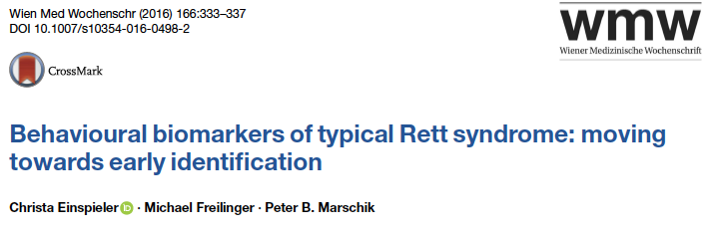

Issues Related to Early Identification of People with Rett Syndrome
Need to develop ways for early identification of people with RTT
  “Too good” infants with evidence of hypotonia and reflux early in life
  Subtle sensitive and specific developmental abnormalities
  MECP2 mutations with well-known relationships to RTT
  Physical and clinical features (careful early head growth assessment)
Bartl-Pokorny KD, et al. J Dev Phys Disabil. 2022;34:1053-69; Einspieler C, et al. Wein Med Wochenschr. 2016;166:333-7.

Slide 10
Closing Remarks
Rett syndrome is a clinical diagnosis
  Most affected individuals are female and have mutations in MECP2
  There are males and people who do not have mutations in MECP2 with Rett syndrome
Developmental delays may be subtle and within the broad range of “normal” development
Regression with loss of spoken language and hand skills characterizes define the disorder
  Regression may occur over many months or rapidly
  Skill loss may occur at different times for specific domains
Identifying abnormalities in head growth rate (even without development of microcephaly) and unusual vocalizations and hand use might allow for early (pre-regression) identification of people with RTT

Slide 11





Thanks to my friends!

Slide 12



Looking for more resources
on this topic?
CME/CE in minutes
Congress highlights
Late-breaking data
Quizzes
Webinars
In-person events
Slides & resources
www.MedEdOTG.com

