Slide 1
Anticoagulation Considerations for AF
Steve Deitelzweig, MD, MMM, SFHM, FACP, FACC
System Chair and Service Line Leader of Hospital Medicine
Medical Director, Regional Business Development
Professor of Medicine – University of Queensland
Ochsner Health
New Orleans, LA

Slide 2
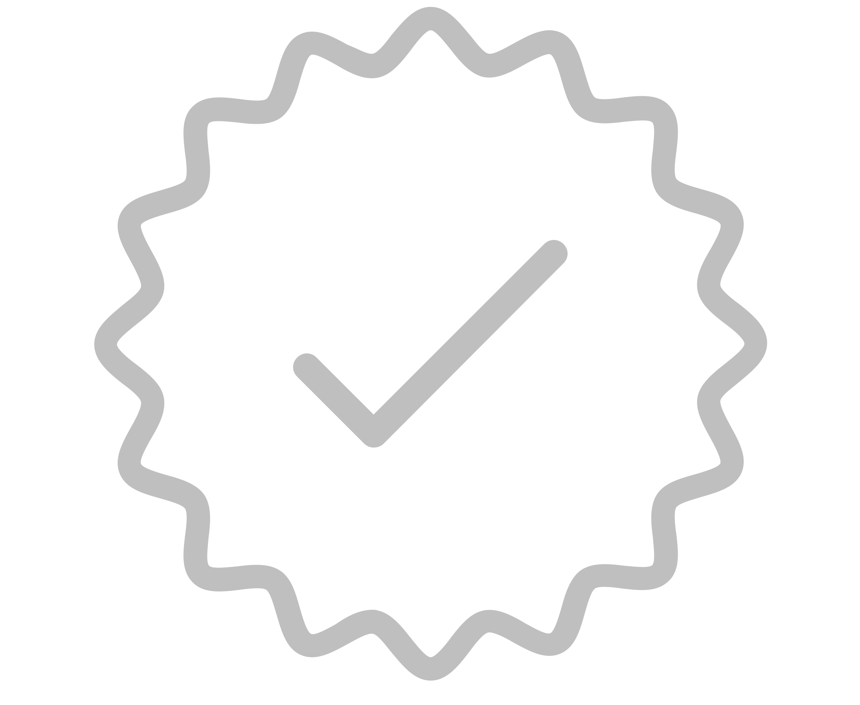
Resource Information
About This Resource
These slides are one component of a continuing education program available online at MedEd On The Go titled Treating and Preventing Clots: Anticoagulation in Atrial Fibrillation and Venous Thromboembolism
Program Learning Objectives:
Discuss appropriate diagnostic criteria and challenges faced in screening patients who may be at risk for blood clots due to either AF or VTE
Identify appropriate candidates for oral anticoagulation when AF or VTE is detected
Develop evidence-based, individualized treatment plans for patients with an indication for oral anticoagulation
MedEd On The Go®
www.mededonthego.com
This content or portions thereof may not be published, posted online or used in presentations without permission.
This content can be saved for personal use (non-commercial use only) with credit given to the resource authors.
To contact us regarding inaccuracies, omissions or permissions please email us at support@MedEdOTG.com

Slide 3
Disclaimer
The views and opinions expressed in this educational activity are those of the faculty and do not necessarily represent the views of Total CME, LLC, the CME providers, or the companies providing educational grants. This presentation is not intended to define an exclusive course of patient management; the participant should use their clinical judgment, knowledge, experience, and diagnostic skills in applying or adopting for professional use any of the information provided herein. Any procedures, medications, or other courses of diagnosis or treatment discussed or suggested in this activity should not be used by clinicians without evaluation of their patient's conditions and possible contraindications or dangers in use, review of any applicable manufacturer’s product information, and comparison with recommendations of other authorities. Links to other sites may be provided as additional sources of information.

Slide 4
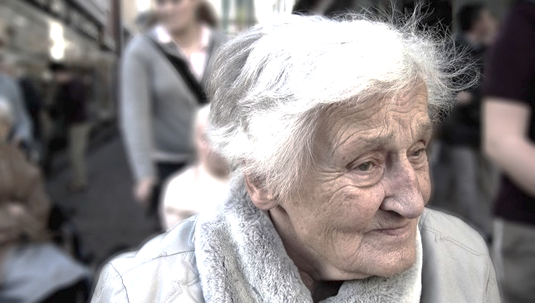
Consider the following patient presenting in your clinic
How could we manage this patient?
Poorly controlled hypertension
Type II diabetes
Risk assessments
CHA₂DS₂-VASc: 5
HAS-BLED: 3
Receiving several different medications for her chronic conditions (polypharmacy)
85-year-old woman, 70 kg
Hypercholesterolaemia
Moderate renal impairment (CrCl: 41 mL/min; creatinine: 97 µmol/L)
Gastric ulcer 2 years ago with major bleeding

Slide 5
Question….
This patient experienced a GI bleed two years ago. How do you think this affects their risk of future GI bleeds, if they were prescribed a NOAC?
Increase their risk
Stay the same
Decrease their risk

Slide 6
GI bleeding outcomes from RCTs; NOACs compared with VKA in NVAF1
Study or subgroup | NOACs events (%/year) | Warfarin events (%/year) | HR (95% CI)
Apixaban² | 105 (0.76) | 119 (0.86) | 0.89 (0.70–1.15)
Dabigatran 110 mg³ | 137 (1.15) | 126 (1.07) | 1.08 (0.85–1.38)
Dabigatran 150 mg³ | 188 (1.56) | 126 (1.07) | 1.48 (1.18–1.85)
Edoxaban 60/30 mg^{*4} | 232 (1.51) | 190 (1.23) | 1.23 (1.02–1.50)
Rivaroxaban^{†5} | – (2.00) | – (1.24) | 1.61 (1.30–1.99)
0.5
1
1.5
2
There are no head-to-head randomized clinical trials comparing the NOACs. Comparisons cannot be made between individual NOACs based on these data.
Favours NOACs
Favours warfarin
*Data are from the safety cohort during the treatment period (which began when the first dose of study drug was administered),
with interval censoring of events during study-drug interruptions that lasted >3 days, except for net clinical outcomes, which are presented for the overall treatment period (which began at the time of randomisation); †Number of events not reported.

Slide 7
ARISTOPHANES: Study Design and Objectives
Real-world data analysis
Databases used in ARISTOPHANES covered ≈56% of the US population (>180 million beneficiaries annually)
Objective: The objective of this retrospective observational analysis was to compare rates of stroke/SE and major bleeding outcomes among a large number of NVAF patients on newly prescribed OACs.
6 MATCHED COHORTS
DOAC vs WARFARIN
1 Apixaban vs warfarin
2 Rivaroxaban vs warfarin
3 Dabigatran vs warfarin
DOAC vs DOAC
4 Apixaban vs rivaroxaban 5 Apixaban vs dabigatran 6 Rivaroxaban vs dabigatran
Primary effectiveness outcome: Stroke/SE* Primary safety outcome: Major bleeding*
Baseline characteristics after 1:1 PSM:
Apixaban vs Warfarin 100,977 matched pairs, with a mean age of 76.1 and 76 for apixaban and warfarin, respectively, and a mean CHA₂DS₂-VASc score of 3.9.
Apixaban vs Rivaroxaban 107,236 matched pairs, with a mean age of 75.2 and 75.1 and a mean CHA₂DS₂-VASc score of 3.8 and 3.7 for apixaban and rivaroxaban, respectively.
Apixaban vs Dabigatran 37,314 matched pairs, with a mean age of 73.2 and 73 for apixaban and dabigatran, respectively, and a mean CHA₂DS₂-VASc score of 3.5.
THE FOLLOWING SLIDES FOCUS ONLY ON THE APIXABAN/WARFARIN, APIXABAN/RIVAROXABAN, AND APIXABAN/DABIGATRAN COHORTS
Apixaban
Apixaban
Apixaban
vs
vs
vs
Warfarin
Rivaroxaban
Dabigatran
N=201,954
N=214,472
N=74,628
Notes:
Lip, 2018, p2934, c1, ¶6

Slide 8
ARISTOPHANES: Efficacy and safety outcomes of NOACs vs warfarin in patients with AF and prior bleeding*
More involved slide
 | NOAC | Warfarin |  |  | HR (95% CI)
Apixaban vs warfarin
Stroke/SE | 2.56 | 3.35 |  |  | 0.76 (0.70, 0.83)
Major bleeding | 9.27 | 13.68 |  |  | 0.67 (0.64, 0.70)
GI bleeding | 5.84 | 7.70 |  |  | 0.75 (0.71, 0.79)
Rivaroxaban vs warfarin
Stroke/SE | 2.48 | 3.15 |  |  | 0.79 (0.71, 0.87)
Major bleeding | 13.39 | 13.27 |  |  | 1.01 (0.96, 1.06)
GI bleeding | 8.59 | 7.33 |  |  | 1.17 (1.10, 1.25)
No. of events (Incidence per 100 person–years)
No. of events (incidence per 100 PY)
0.1
0.3
0.5
0.7
0.9
1.1
1.3
1.5
1.7
Favours NOAC
Favours warfarin

Slide 9
ARISTOPHANES: Efficacy and safety outcomes of NOACs vs NOACs in patients with AF and prior bleeding*
 | NOAC | NOAC |  |  | HR (95% CI)
Apixaban vs. dabigatran (ref.)
Stroke/SE | 1.82 | 2.60 |  |  | 0.60 (0.56, 0.63)
Major bleeding | 8.25 | 10.90 |  |  | 0.75 (0.67, 0.81)
GI bleeding | 5.30 | 6.86 |  |  | 0.75 (0.67, 0.85)
Apixaban vs. rivaroxaban (ref.)
Stroke/SE | 2.24 | 2.63 |  |  | 0.85 (0.76, 0.96)
Major bleeding | 8.87 | 13.54 |  |  | 0.64 (0.61, 0.68)
GI bleeding | 5.62 | 8.69 |  |  | 0.64 (0.59, 0.68)
Dabigatran vs. rivaroxaban (ref.)
Stroke/SE | 2.55 | 2.45 |  |  | 1.04 (0.87, 1.25)
Major bleeding | 10.87 | 13.27 |  |  | 0.84 (0.77, 0.92)
GI bleeding | 6.82 | 8.61 |  |  | 0.81 (0.73, 0.90)
More involved slide
No. of events (Incidence per 100 person–years)
No. of events (incidence per 100 PY)
No. of events (incidence per 100 PY)
No. of events (Incidence per 100 person–years)
0.1
0.3
0.5
0.7
0.9
1.1
1.3
1.5
1.7
Favours comparator
Favours reference

Slide 10
ARISTOPHANES: Experiencing a major vs non-major GI bleed whilst on an OAC adversely affects stroke/SE and major bleeding risk
 | Major GI bleeding | Non-major GI bleeding (reference)
 | Number of events (Incidence per 100 PY) |  | HR (95% CI) |  | p-value
Stroke/SE | 567 (3.75) | 1,127 (2.32) | 1.57 (1.42, 1.74) |  | <0.001
Ischaemic | 471 (3.10) | 858 (1.76) | 1.71 (1.53, 1.92) |  | <0.001
Haemorrhagic | 50 (0.32) | 203 (0.41) | 0.76 (0.56, 1.04) |  | 0.085
SE | 49 (0.32) | 73 (0.15) | 2.11 (1.46, 3.04) |  | <0.001
Major bleeding | 2,339 (17.92) | 2,869 (6.13) | 2.79 (2.64, 2.95) |  | <0.001
GI | 1,547 (11.21) | 1,045 (2.16) | 4.95 (4.57, 5.35) |  | <0.001
ICH | 104 (0.67) | 463 (0.94) | 0.70 (0.57, 0.87) |  | 0.001
Other | 901 (6.15) | 1,488 (3.10) | 1.92 (1.76, 2.08) |  | <0.001
More involved slide
Conclusion: major GI bleeding significantly increased the risk of stroke/SE and subsequent major bleeding events compared with the risks without a major GI bleed¹
0.1
1
1.9
2.8
3.7
4.6
5.5
Rate major GI bleeding
Favours no major GI bleeding

Slide 11
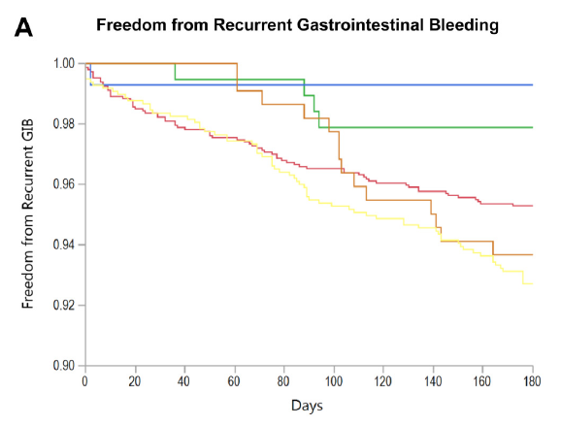
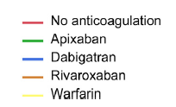
NOAC vs VKA re-initiation after GI bleeding in AF: An independent analysis
GIB, gastrointestinal bleed. Tapaskar N, et al. Clin Gastroenterol Hepatol. 2022;20:381–389.e9.
Retrospective analysis of 2,991 patients with AF hospitalised for GIB on anticoagulants. IBM MarketScan Databases claims from January 2008 through December 2017 (warfarin, n=1872; rivaroxaban, n=676; dabigatran, n=293; and apixaban, n=250)
Warfarin resumption was associated with an increased risk of recurrent GIB compared with no anticoagulant resumption (HR, 2.12; 95% CI (1.43–3.14); P=0.0002)
There was no association between NOAC resumption and recurrent bleeding (HR, 1.43; 95% CI (0.81–2.52); P=0.22)
Rivaroxaban was the only individual NOAC that was associated with recurrent GIB (HR, 2.73; 95% CI (1.43–5.20); P=0.002)
More involved slide
Kaplan–Meier curves for recurrent GIB-free survival based on the initial anticoagulant prescription at the time of admission for the index GIB. P=0.001 for differences among curves using the log-rank test.

Slide 12
Summary / Key take-home messages
In clinical practice, ARISTOPHANES subgroups from WE claims databases like those patients with GI Bleeding and other recent publications are poised to improve the management of our NVAF patients

Slide 13
Outcomes Question
How do you find real-world evidence studies most useful in your clinical practice?
A
Real-world evidence studies help supplement information from randomized controlled trials in a real-world practice setting
B
Real-world evidence studies provide information that helps enhance my understanding of the effectiveness and safety of a therapy
C
I do not find real-world evidence studies useful

Slide 14
Looking for more resources on this topic?
CME/CE in minutes
Congress highlights
Late-breaking data
Quizzes
Webinars
In-person events
Slides & resources
www.MedEdOTG.com

