Slide 1
Management of ICH in the Anticoagulated Patient Using Specific Reversal Therapy: Importance of Timing
Adrian R. Parry-Jones, FRCP, PhD
Geoffrey Jefferson Brain Research Centre University of Manchester Manchester, UK

Slide 2
Resource Information
About This Resource
These slides are one component of a continuing education program available online at MedEd On The Go titled Real World Data and the Management of Intracranial Hemorrhages (ICH) in Anticoagulated Patients
Program Learning Objectives:
Employ appropriate treatment management strategies to address the critical clinical aspects of ICH and hematoma expansion
Explain when and how to initiate appropriate reversal agents in ICH bleeds
Discuss the need to develop and implement protocols and local care pathways based on existing evidence-based medicine guidelines to improve the management of ICH bleeds
MedEd On The Go®
www.mededonthego.com
This content or portions thereof may not be published, posted online or used in presentations without permission.
This content can be saved for personal use (non-commercial use only) with credit given to the resource authors.
To contact us regarding inaccuracies, omissions or permissions please email us at support@MedEdOTG.com

Slide 3
Disclaimer
The views and opinions expressed in this educational activity are those of the faculty and do not necessarily represent the views of Total CME, LLC, the CME providers, or the companies providing educational grants. This presentation is not intended to define an exclusive course of patient management; the participant should use their clinical judgment, knowledge, experience, and diagnostic skills in applying or adopting for professional use any of the information provided herein. Any procedures, medications, or other courses of diagnosis or treatment discussed or suggested in this activity should not be used by clinicians without evaluation of their patient's conditions and possible contraindications or dangers in use, review of any applicable manufacturer’s product information, and comparison with recommendations of other authorities. Links to other sites may be provided as additional sources of information.

Slide 4
Case History and Examination
61-year-old male patient, prestroke mRS 0
Known type 2 diabetes mellitus, hypertension, TIA 10 months prior, atrial fibrillation
Anticoagulated with apixaban 5 mg BID
Found with right-sided weakness and drowsiness at 9 AM today (1 hour ago)
Examination: GCS M6 V2 E4 (12), right hemiplegia and neglect, NIHSS 21
BP 216/114 on arrival

Slide 5
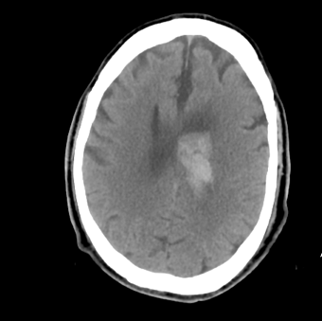
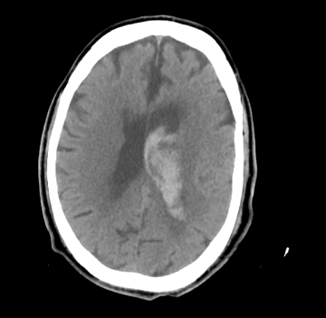
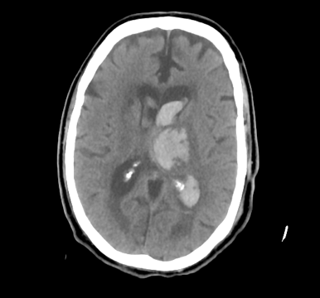
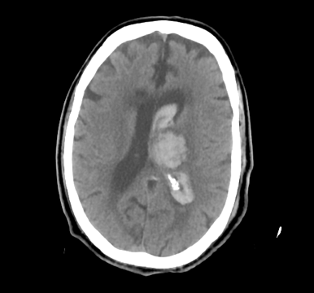
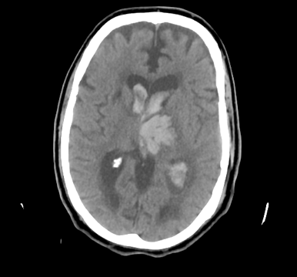
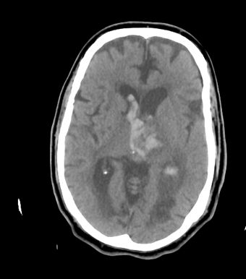
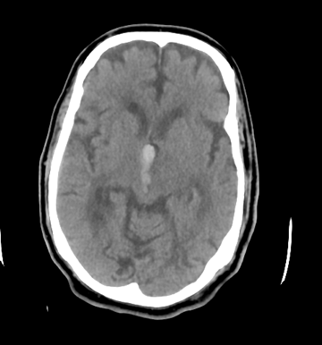
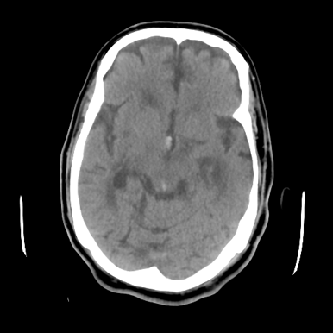
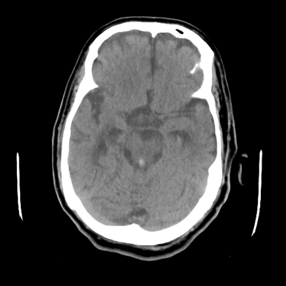
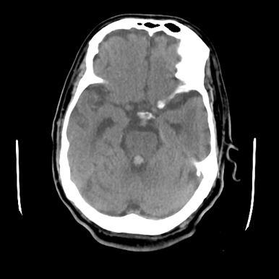
CT Brain Scan
Volume (ABC/2)=20.0 ml

Slide 6
Further Assessment
Patient unaccompanied and last apixaban dose unknown
Call to patient’s son:
Patient lives alone, looks after his own medication
Last seen well yesterday at 11 AM, found with weakness today
Seems to have slept in his bed, got up, and dressed
Poor compliance and recently given a blister pack to help with this. Blister pack not with patient
Some lab results back: eGFR >90
Now 11 AM. Could be 2 to 24 hours after onset

Slide 7
Management
Phone call to Haematology (30 minutes later), advised give PCC, treatment then commenced
Andexanet alfa not currently available in England for ICH
BP lowering commenced shortly afterwards
Discussed with Neurosurgery. Not for immediate intervention
Transferred to High Dependency Unit for arterial line and BP management
Transferred back to local hospital on Day 6

Slide 8
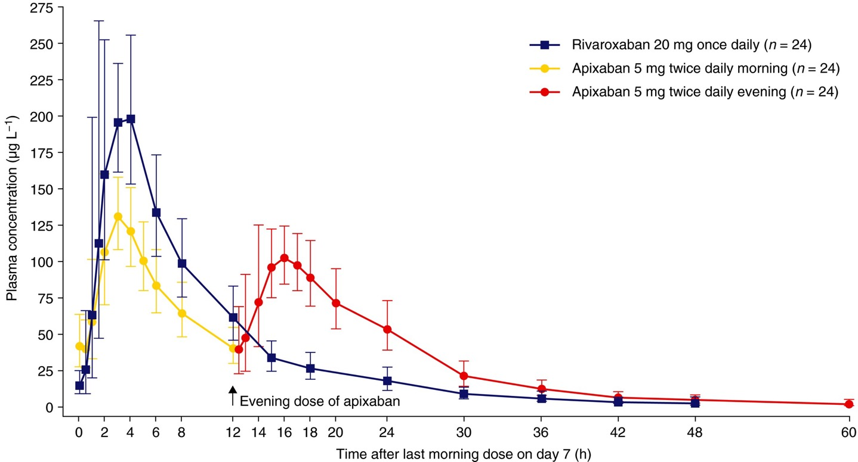
Pharmacokinetics of Anti-Xa DOACs
Taken as prescribed
Missed morning dose
Missed both doses

Slide 9
Haematoma Expansion: Risk Factors
Time
Volume
2 h
24 h
20 ml
Individual patient data meta-analysis: Curves derived from 5076 patients not taking anticoagulant therapy
Model underestimated probability of expansion in 351 patients taking anticoagulant therapy
Discrimination remained good (0·73, 0·68–0·79) versus non-anticoagulated validation cohort (0·76, 0·73–0·79)

Slide 10
Summary
Approximately 10 to 20% of ICHs occur on anticoagulants
Delays increase the risk of expansion
Decide quickly whether to treat
Two key times to consider:
Time of last anticoagulant
Time since ICH onset
Other key patient factors:
ICH volume (risk of expansion)
Very poor prognosis (futility)

Slide 11
Looking for more resources on this topic?
CME/CE in minutes
Congress highlights
Late-breaking data
Quizzes
Webinars
In-person events
Slides & resources
www.MedEdOTG.com

